Slide 1
Implementation of a Multi-Sensor Algorithm for Time Series Snow Cover Mapping in Lombardy, Italy
Geoinformatics Project
Prof. Giovanna Venuti & Daniella Stopinna
Hadi Kheiri Gharajeh – 10946669
Ola Elwasila Abdelrahman Yousif - 10963045

Slide 2
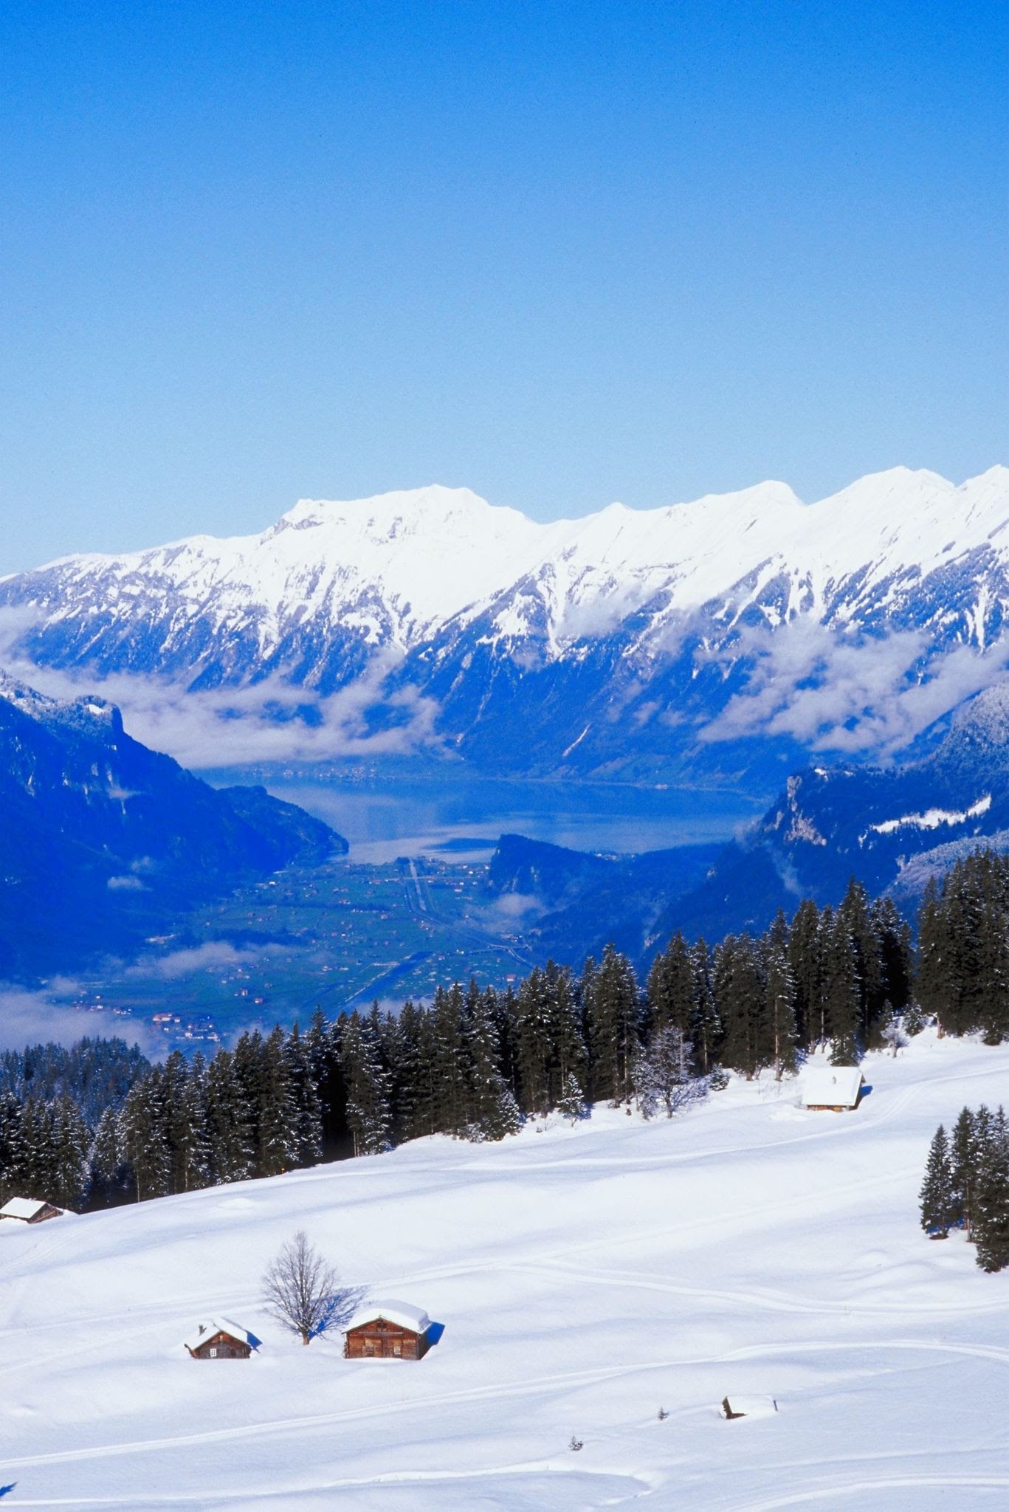
Agenda & Scope
Development of a Tool for the Comparison of Available Snow Cover Products for the Alpine Area
Implementation of a Snow Cover Mapping Algorithm for the Lombardy Region (Italy)
Focus period:
Winter seasons ( October to April)
Years 2022 – 2023
Notes:
: Pixel by Pixel agreement and difference map

Slide 3
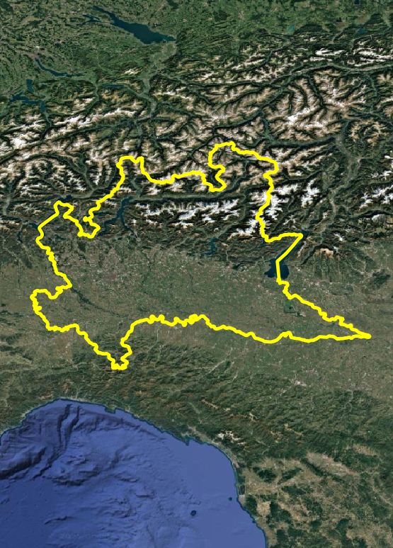
Overview Snow Products and Comparison
Available Snow Cover Products: MODIS, GFSC, Sentinel-2, Sentinel-3
Preprocessing: Resampling, Reprojection, Temporal aggregation & Clip to ROI.
Key result: Harmonized multi-sensor snow cover datasets over the Lombardy Alps for direct side-by-side comparison

Slide 4
Overview for Algorithm implantation
Algorithm Implementation
Based on previous comparison, Sentinel-2 chosen for detailed mapping.
Tested Algorithm:
- Random Forest classifier
- Let It Snow threshold-based logic
- Regression vs. MODIS
Testing Phase: Applied and evaluated on multiple winter weeks of 2022- 2023
Let-It-Snow (LIS) algorithm (https://gitlab.orfeo-toolbox.org/remote_modules/let-it-snow)

Slide 5
Data Information
Product | Source | Spatial Resolution | Temporal Resolution
MODIS | MODIS (NASA LP DAAC) | 500 m | Single-date acquisition
GFSC | Copernicus High-Res Snow & Ice | 60 m | Daily composites
Sentinel-2 | ARPA Lombardy | 20 m | Bi-weekly composites (Mon–Sun)
Sentinel-3 | ARPA Lombardy | 300 m | Weekly composites (Mon–Sun)
Notes:
GFSC: MODIS + S2

Slide 6
Prepocessing
1

Slide 7
General Harmonization & Comparison Workflow
Resample to a uniform grid (60 m) using appropriate interpolation
1- Ingest Raw Masks
2- Reclassify & Threshold
3- Spatial Harmonization
4- Temporal Aggregation
5- Alignment:
6- Clip
7- Side-by-Side Comparison

Slide 8
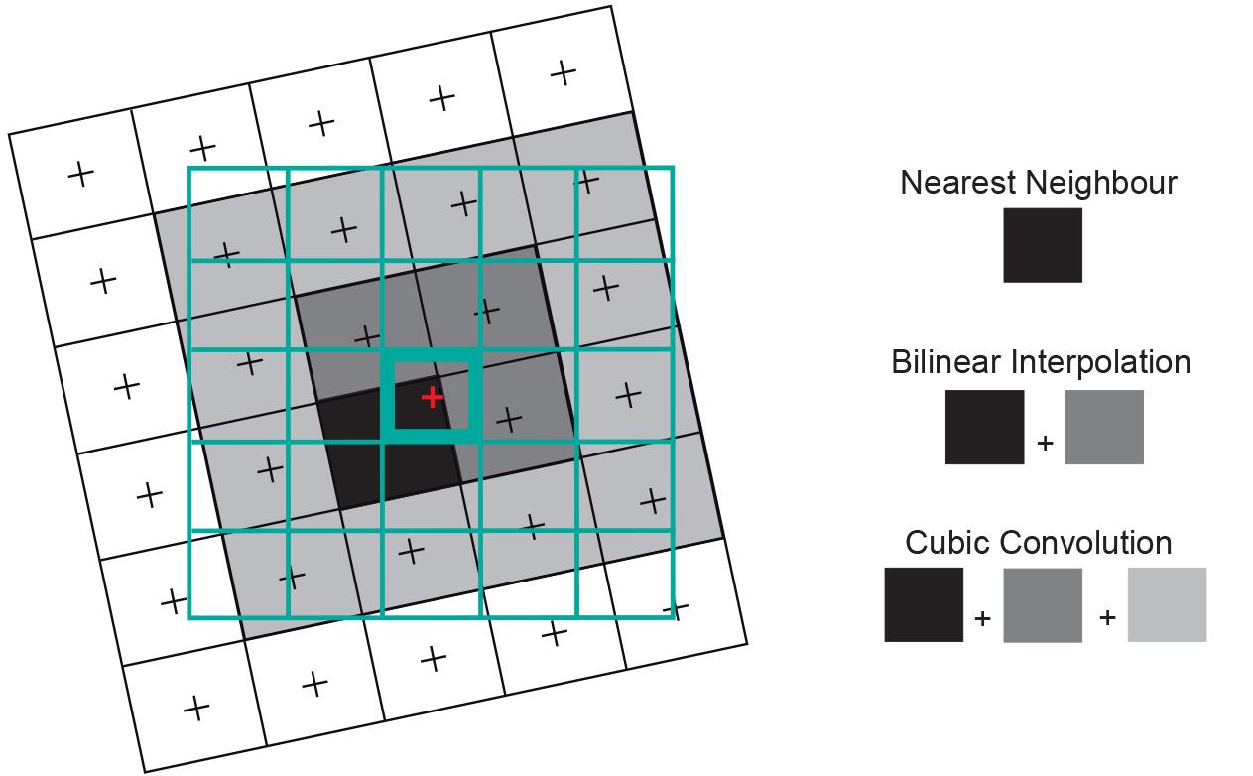
Interpolation Methods
Notes:
Continuous → Bilinear interpolation smoothly weights neighboring pixels to estimate an intermediate value at the new grid. This preserves gradients (e.g. partial‐cover edges) and avoids abrupt “stair-stepping” that you’d get with nearest-neighbor.
discrete → nearest-neighbor: Nearest-neighbor ensures each resampled pixel inherits an exact QC code from the closest source pixel,

Slide 9
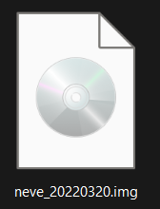
MODIS Data Processing breakdown
Step | Function | Purpose | Key Settings
Reproject & Resample | reproject_resample() | Reproject raw MODIS snow and resample | • dst_crs='EPSG:32632’ • dst_res=(60,60) • resampling_method = Resampling.nearest • nodata=src.nodata or 255
Weekly Aggregation | aggregate_weekly() | Stack daily masks into ISO-week composites and binarize | • method='max’

Slide 10
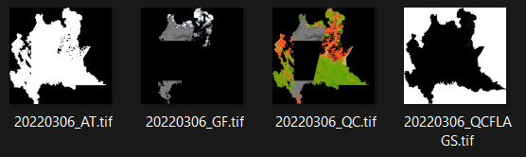
GFSC Data Processing breakdown
Step | Function | Purpose | Key Settings
Resample & Reproject | resample_reproject_gfsc() | • Load each *_GF.tif + *_QC.tif pair • Mask out invalid QC codes & original nodata • Threshold GF ≥ 20 → snow (1), < 20 → no-snow (0), NaN → nodata (255) • resample & reproject to common grid | • QC resampling: nearest • GF resampling: bilinear • threshold=20.0 (≥20 → snow) • acceptable_qc={0,1,2,3} • CRS: EPSG:32632 • Resolution: 60 m
Weekly Aggregation | aggregate_weekly_gfsc() | Group daily binaries (0/1/255) by ISO-week (parsed from YYYYMMDD in filename) | • method='max' • Groups by ISO-week (YYYY_Www from filename)

Slide 11
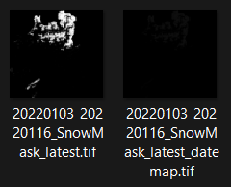
S2 Data Processing breakdown
Step | Function | Purpose | Key Settings
Load Masks & Datemap | process_s2_weekly() | • Find each *_SnowMask_latest.tif & its paired _datemap.tif • Extract 14-day window start date via regex | • date_re = r"(\d{8})_\d{8}“ • Start = m.group(1) → ISO-week A; +7 days → ISO-week B
Split & Merge into ISO-Weeks | process_s2_weekly() | Use datemap values 1–7 → Week A; 8–14 → Week B | • method='max’ • nodata = src.nodata or 255
Reproject & Resample | process_s2_weekly() | Warp each weekly mask to common grid | • calculate_default_transform(..., resolution=60) • dst_crs='EPSG:32632’ • resampling_method = Resampling.nearest

Slide 12
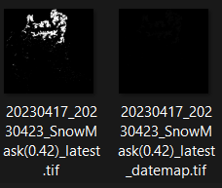
S3 Data Processing breakdown
Step | Function | Purpose | Key Settings
Group by ISO-Week | reproject_s3_weekly() | Scan *_SnowMask*.tif files (skip _datemap.tif), parse date (YYYYMMDD) → ISO week buckets | • Filename digits → date → date.isocalendar() → "{year}_W{week:02d}"
Temporal Max-Stack | reproject_s3_weekly() | Stack daily masks (float32), mask out any >1 → NaN, then apply np.nanmax across the week | • Values >1 → np.nan • Groups by ISO-week
Reproject & Resample | reproject_s3_weekly() | Warp each weekly mask to common grid | • dst_crs='EPSG:32632’ • dst_res=(60,60) • resampling=Resampling.nearest • nodata=255

Slide 13
Weekly Availability
1. Product Availability Windows
MODIS: Weeks 2021_W51 – 2023_W11
GFSC: Weeks 2021_W44 – 2023_W04
Sentinel-2: Weeks 2021_W01 – 2023_W14
Sentinel-3: Weeks 2021_W01 – 2023_W14
Product | 2021_W49 | 2021_W50 | 2021_W51 | 2021_W52 | 2022_W01 | 2022_W02 | 2022_W03 | 2022_W04 | 2022_W05
MODIS | – | – | ✔ | ✔ | – | ✔ | – | ✔ | –
GFSC | ✔ | ✔ | ✔ | ✔ | ✔ | ✔ | ✔ | ✔ | ✔
Sentinel-2 | – | – | – | – | ✔ | ✔ | ✔ | ✔ | ✔
Sentinel-3 | – | – | – | – | ✔ | ✔ | ✔ | ✔ | ✔

Slide 14
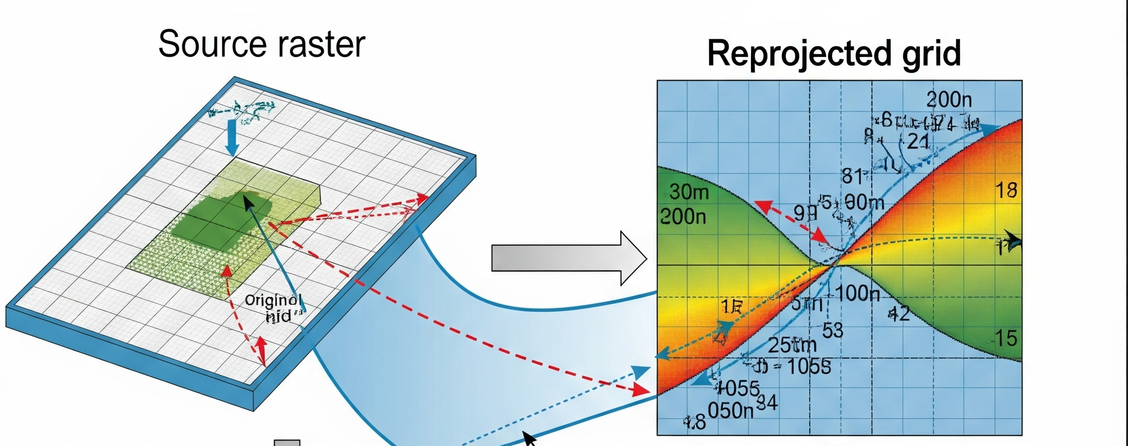
Alignment and Clip
Step | Function | Purpose | Key Settings
1. Grid Alignment | match_raster_grid() | Alignment | • resampling_method=nearest • dst_crs, dst_transform, dst_width & dst_height from reference • preserves nodata by pre-fill
2. ROI Clipping | clip_weekly_to_roi() | Crop each aligned raster to the Region of Interest | • shapes = ROI GeoJSON/polygon • crop=True for tight envelope • fills outside ROI with nodata

Slide 15
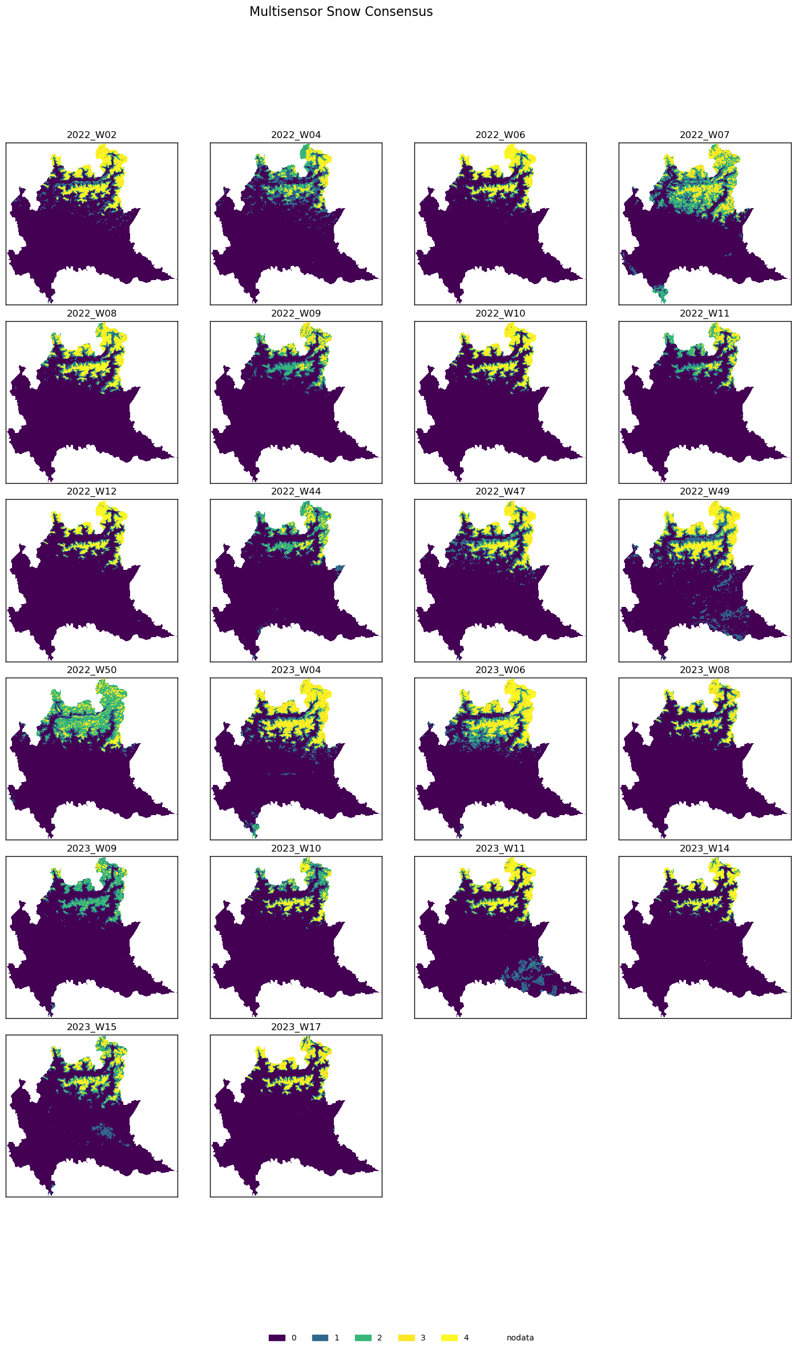
Multi-Sensor Weekly Snow Consensus

Slide 16
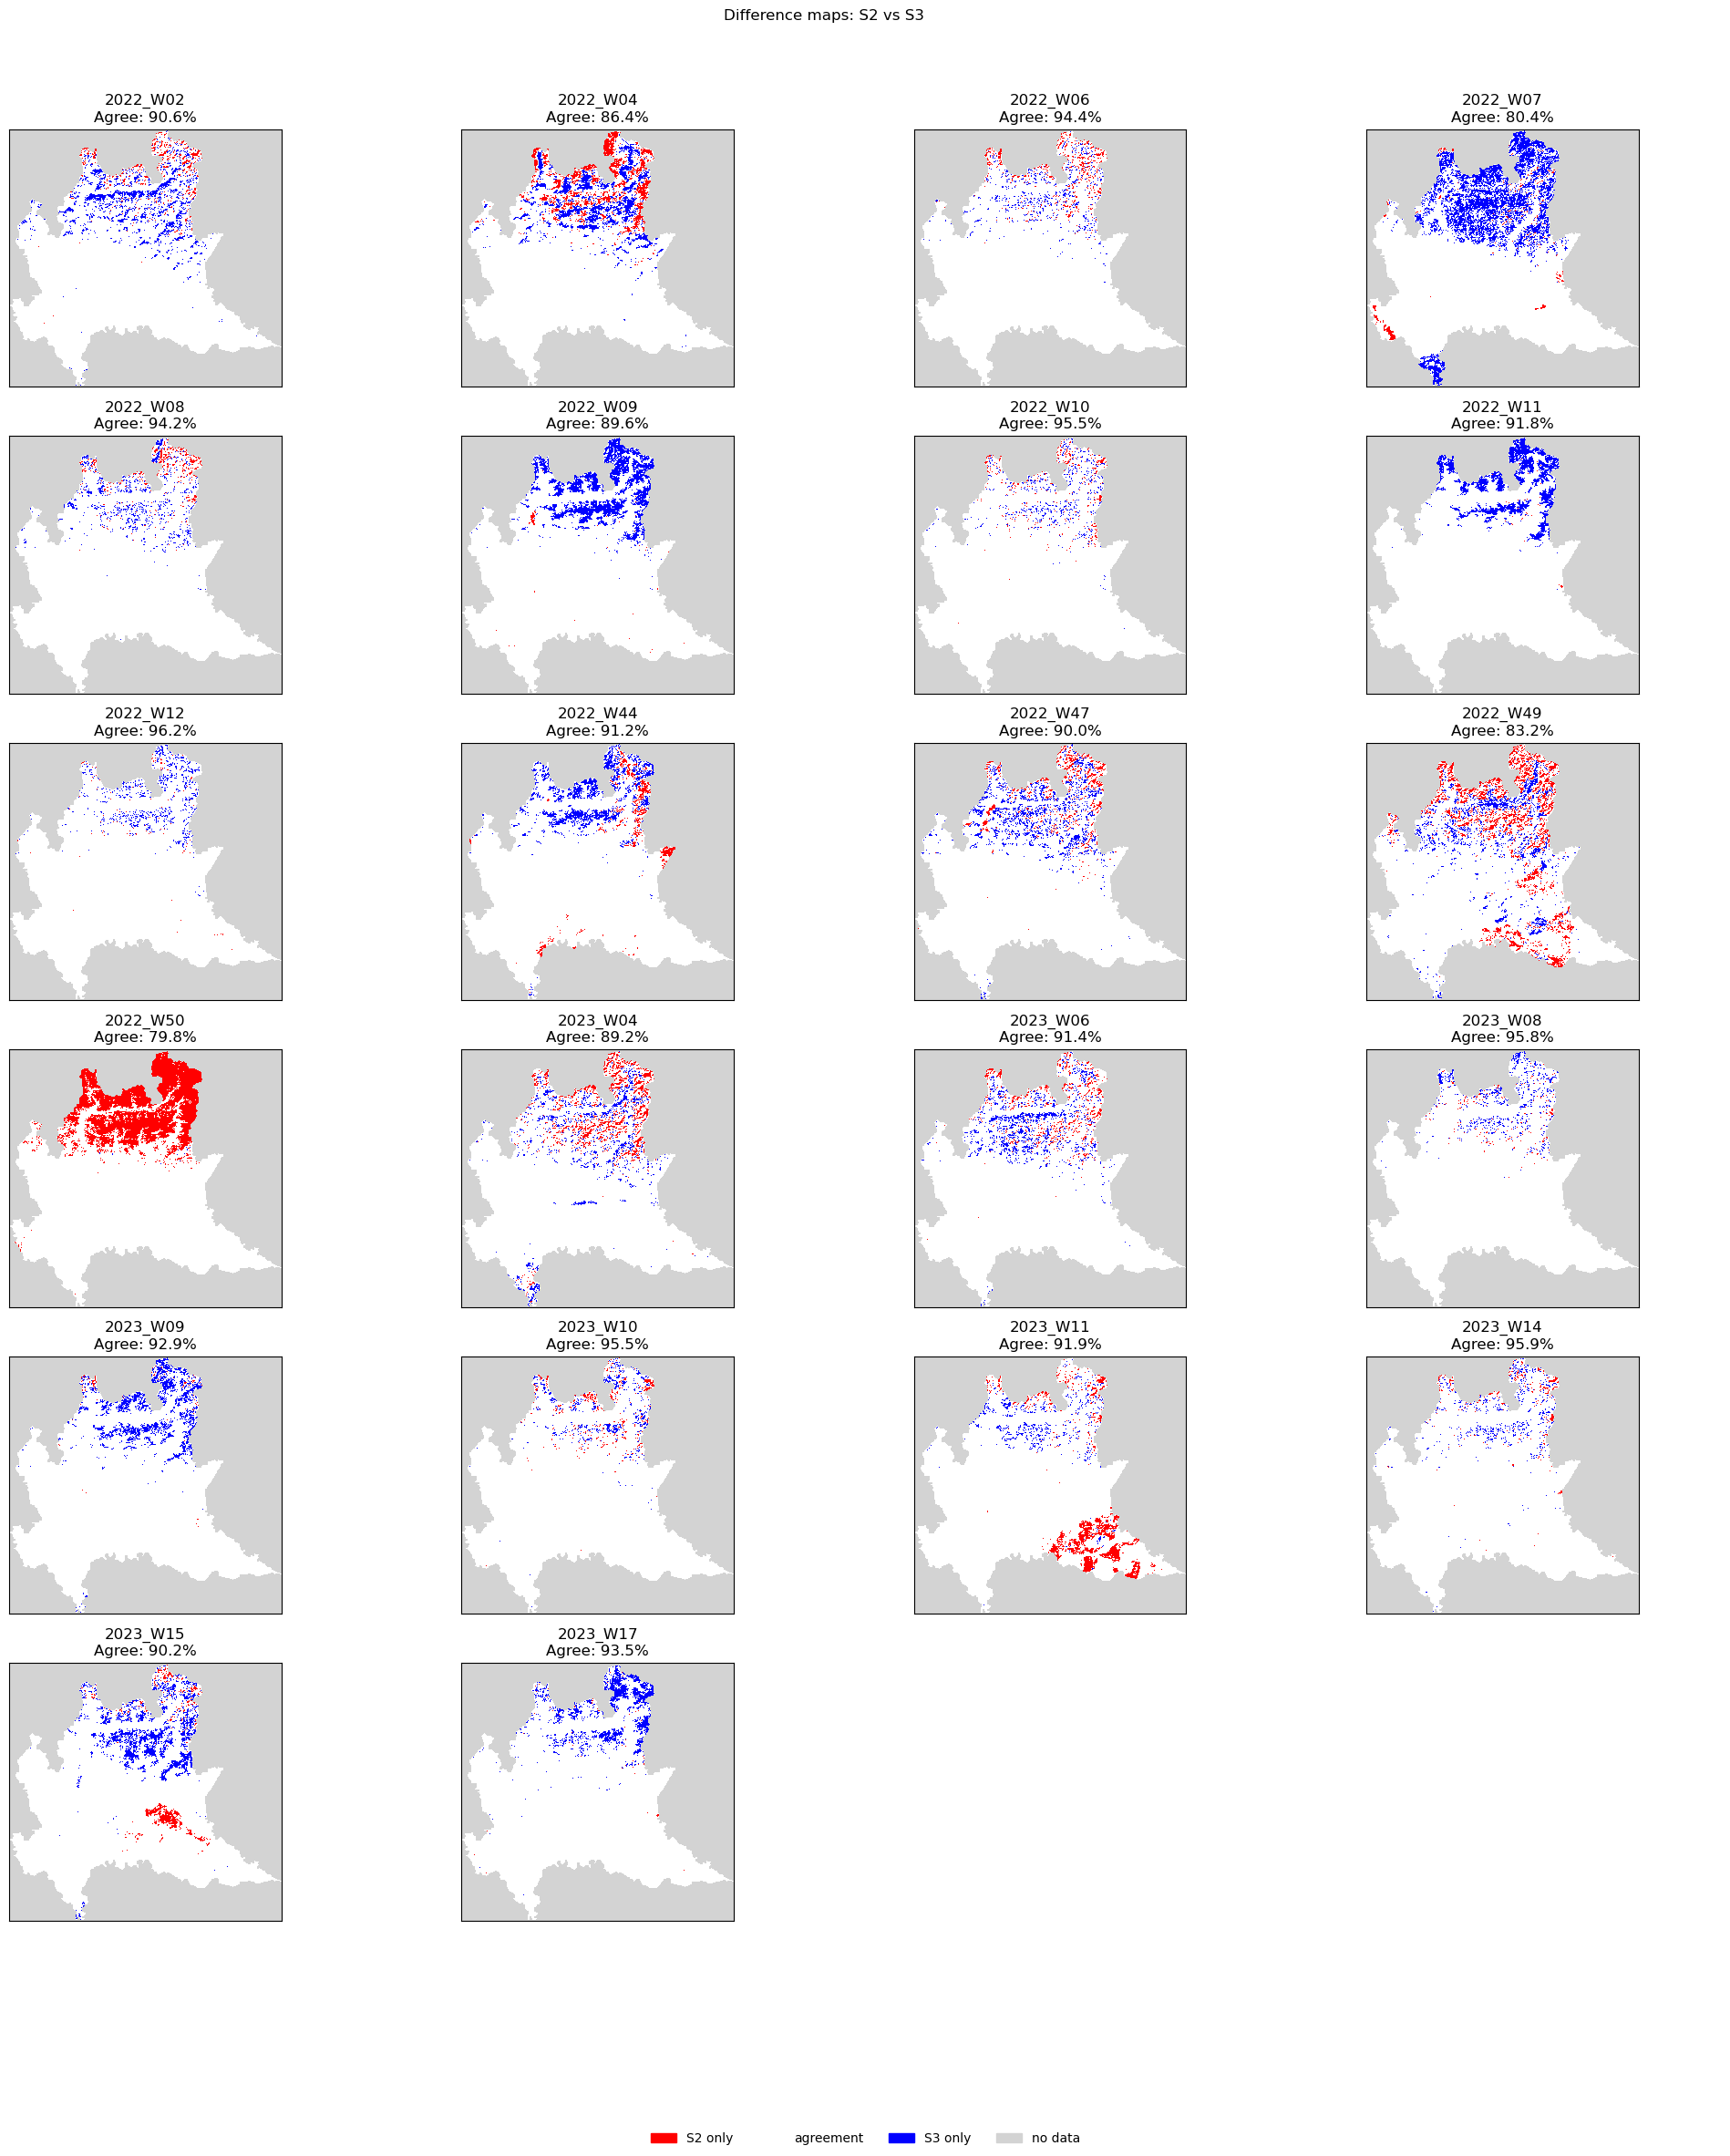
Weekly Snow-Cover Agreement: S2 vs S3

Slide 17
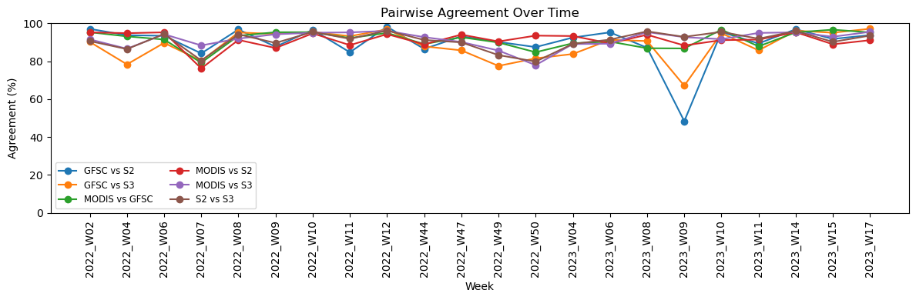
Temporal Trends in Pairwise Snow-Cover Agreement
Notes:
A line chart titled “Pairwise Agreement Over Time” shows weekly snow‐cover agreement percentages (y-axis, 0–100 %) across selected ISO weeks (x-axis, labeled 2022_W02 through 2023_W17). Six colored lines compare each sensor pair (legend: GFSC vs S2 in blue, GFSC vs S3 in orange, MODIS vs GFSC in green, MODIS vs S2 in red, MODIS vs S3 in purple, S2 vs S3 in brown). All comparisons hover near 85–98 % agreement most weeks, with a pronounced dip to ~48 % for GFSC vs S2 at week 2023_W09.
Key Observations
High Consistency: Most pairs hover around 90–98% agreement for the majority of weeks.
Notable Dips:
GFSC vs S2 plunges to ~48% in 2023_W09 (likely cloud/processing anomalies in one dataset).
GFSC vs S3 dips below 70% in 2023_W09 as well—suggests that week had widespread discrepancies across both GFSC comparisons.
Strongest Pair: MODIS vs S3 (purple) generally shows the highest alignment, often exceeding 95%.
MODIS vs GFSC and MODIS vs S2 remain very stable, rarely dropping below 85%.

Slide 18
Algorithm implementation
3

Slide 19
Snow Mapping from Sentinel-2
The first approach implemented for snow mapping was a supervised classification method using Random Forest.
MODIS provided the binary ground truth label (snow/no snow), and the snow masks from GFSC, Sentinel-2, and Sentinel-3 were stacked as features.
Only pixels with valid values across all layers were retained for training.
The classifier learned to associate the agreement patterns between the different snow products and MODIS, producing a new binary snow mask.
Accuracy, precision, and recall were computed by comparing the predictions with MODIS labels.

Slide 20
Snow Detection Using Supervised Classification
The classifier achieved high overall accuracy (94%) in distinguishing between snow and no-snow pixels. It performed particularly well in detecting snow-free areas (recall = 97%). While the snow class had a slightly lower recall (80%), the model still demonstrated robust performance without requiring manual thresholding
 | Precision | Recall | F1- Score | Support
No Snow(0) | 0.95 | 0.97 | 0.96 | 4897358
Snow(1) | 0.87 | 0.80 | 0.83 | 1161704

Slide 21
Agreement Metrics: Snow Product vs MODIS
To assess the standalone performance of each snow cover product, we conducted a direct comparison between each product (GFSC, Sentinel-2, Sentinel-3) and the MODIS reference layer. For each product, we masked invalid pixels and computed key classification metrics — accuracy, precision, recall, and F1-score — using MODIS as ground truth. This step helped us understand how well each source performs independently, and confirmed the added value of combining them in the classifier..
Product | Precision | Recall | F1-Score | Accuracy
GFSC | 0.96 | 0.52 | 0.67 | 0.9036
S2 | 0.94 | 0.58 | 0.72 | 0.8947
S3 | 0.88 | 0.62 | 0.73 | 0.8926
21

Slide 22
Let It Snow!
The LIS method uses rule-based logic to classify each pixel as snow or no-snow.
Classification is based on spectral indices, primarily NDSI and NDVI thresholds.
The logic is applied in multiple stages to improve accuracy:
- Initial classification based on index thresholds.
- Slope correction using a Digital Elevation Model (DEM) to remove false positives on steep terrain.
- Cloud and shadow removal to prevent misclassification due to atmospheric effects.
The process is designed to adapt to different sensors through sensor-specific rules.

Slide 23
Let It Snow (Our Version)
We adopt a simplified version of the LIS logic, focusing only on binary classification: snow or no-snow
Instead of computing spectral indices, we apply a basic rule to existing snow cover products (GFSC, Sentinel-2, Sentinel-3).
The logic is applied in multiple stages to improve accuracy:
- Initial classification based on index thresholds.
- Slope correction using a Digital Elevation Model (DEM) to remove false positives on steep terrain.
- Cloud and shadow removal to prevent misclassification due to atmospheric effects.
The process is designed to adapt to different sensors through sensor-specific rules.

Slide 24
Let it Snow !
Product | Precision | Recall | F1-Score | Accuracy
GFSC | 0.96 | 0.52 | 0.67 | 0.9036
S2 | 0.94 | 0.58 | 0.72 | 0.8947
S3 | 0.88 | 0.62 | 0.73 | 0.8926
Both approaches produced identical results. This is expected, as the available input data (GFSC, S2, S3) already encode binary snow/no-snow decisions. Without access to raw spectral bands (e.g., B3, B11), the Random Forest model is effectively replicating the same logic used in the original masks.
As a result, the classifier does not learn new decision boundaries but simply reproduces the binary structure already present in the input, leading to identical performance metrics.

Slide 25
Regression Analysis
To evaluate the consistency and agreement between different snow cover products and MODIS (used as reference), we applied linear regression analysis.
This method helps quantify how well each product's snow/no-snow detection matches MODIS over common areas and weeks.
By comparing pixel-level binary values (1 = snow, 0 = no snow), we computed the slope and correlation coefficient for each product-week combination.
A slope close to 1 indicates that the product agrees well in magnitude with MODIS.
A correlation coefficient closer to 1 reflects strong linear agreement in spatial snow patterns.
To ensure robust comparison, all rasters were aligned spatially and temporally, and 500,000 pixels were sampled per week to reduce memory usage.

Slide 26
Regression Analysis
GFSC had the highest average correlation with MODIS (0.847) and a consistent slope close to 1 (avg: 0.871), indicating strong agreement in snow detection.
Sentinel-2 (S2) showed a moderate slope (0.640) but lower correlation (0.304), suggesting some mismatch in spatial snow cover patterns.
Sentinel-3 (S3) had similar behavior to S2, with slightly lower slope and slightly higher correlation than S2.
Product | Slope | Correlation
GFSC | 0.871 | 0.847
S2 | 0.640 | 0.304
S3 | 0.626 | 0.377

Slide 27
Future Improvements
Work on band data in order to improve the quality of tha classification and properly test the Let-It-Snow algorithm
Usage of Commercial Satellite Data

